Slide 1
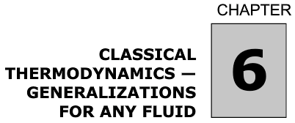

Slide 2
Measurable Quantities:
T, P, V
Thermodynamic Balances:
S, H, U, G (Gibbs Free
Energy), A (Helmholz Free
Energy)
Example:
ΔH = C_{p} ΔT
C_{p} = (δH/δT)_{p}
Relate measurable quantities to thermodynamic quantities for balances through differential calculus (materials constants like C_{p}, C_{v}, μ_{JT}, α_{p}, κ_{T} and P, V, T).

Slide 3





Simple System:
-No Gradients
-Reversible
-No fields or walls
U(S,V)
H(S,P)

Slide 4




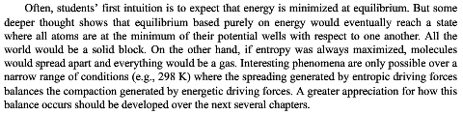
Gibbs and Helmholtz Free Energies
isochoric
isobaric

Slide 5


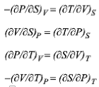
U(S,V)
H(S,P)
A(T,V)
G(T,p)
Thermodynamic
Square
U=H-PV=A+TS
A=G-PV=U-ST
H=U+PV=G+TS
G=H-TS=A+PV

Slide 6
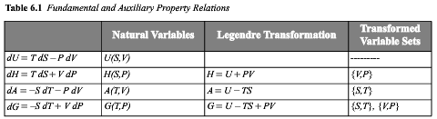

Slide 7
Legendre Transformations
From the energy balance on the first slide U depends on S and V:
dU = TdS - PdV
(dU/dV)_{S} = -P
is not useful since we can’t hold S constant very easily
it would be more useful to have a different energy expression that depends on V and T rather than V and S.
To obtain this we find the desired variable, T = (dU/dS)_{V}.
T is the conjugate variable of S in the dU equation.
A = U – TS :: dA = dU – TdS –SdT :: dA = -SdT - PdV
The Legendre transform of the dU equation is dA = -SdT - PdV.
(dA/dV)_{T} = -P

Slide 8
Legendre Transformations
Start with:
dA = -SdT – PdV Depends on V and T
P is the conjugate to V.
G = A + PV :: dG = dA + PdV + VdP :: dG = -SdT + VdP
G = PV - ST

Slide 9
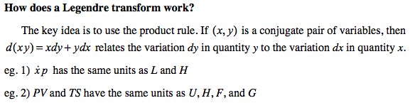
Legendre Transformations
https://www.aapt.org/docdirectory/meetingpresentations/SM14/Mungan-Poster.pdf Accessed 3/2/15

Slide 10
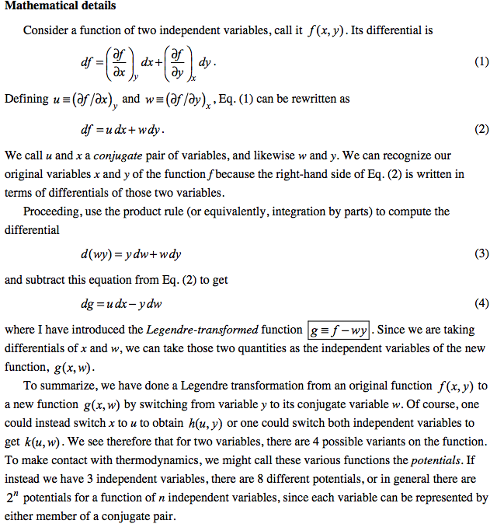

Slide 11
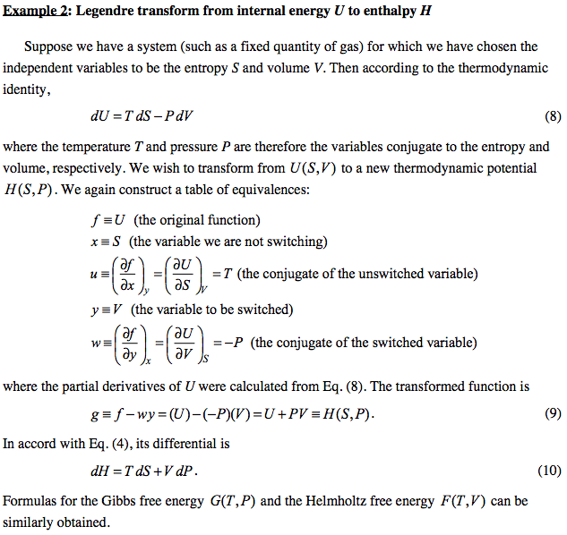

Slide 12
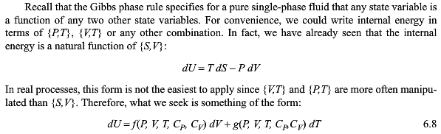
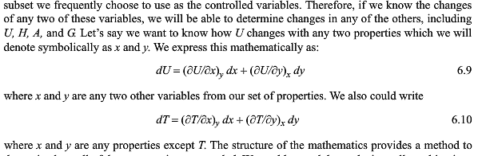

Slide 13

Standard Tabulated Partial Differential Terms
for Thermodynamics:

Slide 14
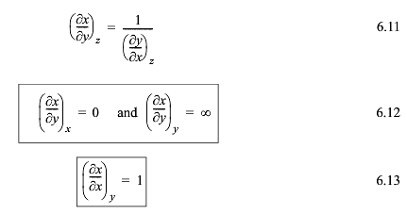


Differential Equalities Needed to Solve
Thermodynamic Problems:
Expand in two variables, x and y

Slide 15
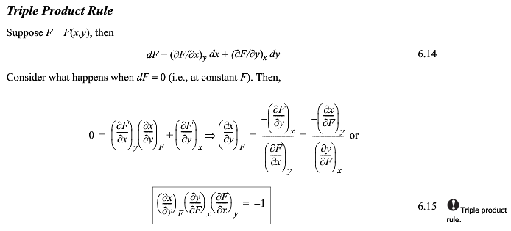


It would be useful to remember this somehow

Slide 16
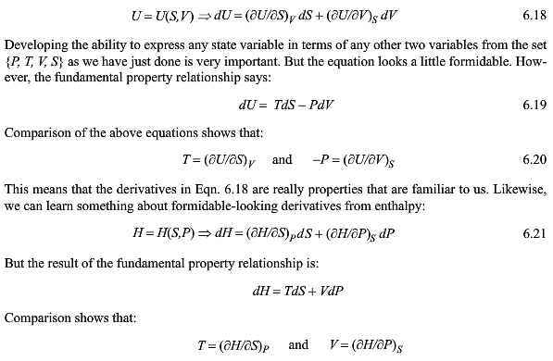

Slide 17
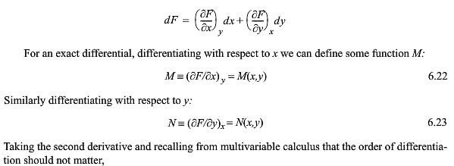
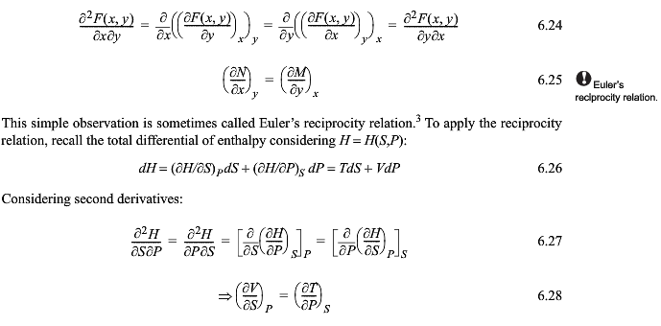

Slide 18
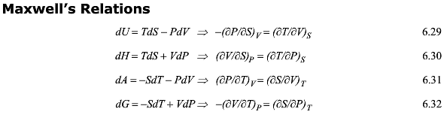

Slide 19
Thermodynamic
Square

Slide 20
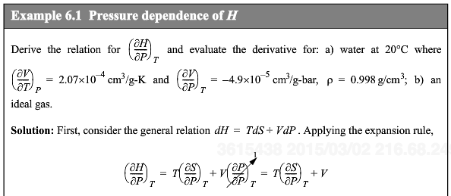
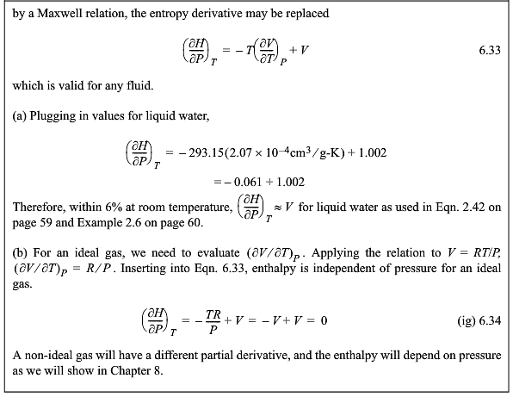

Slide 21
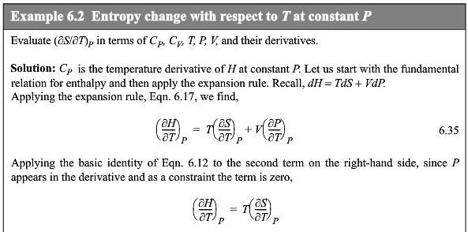
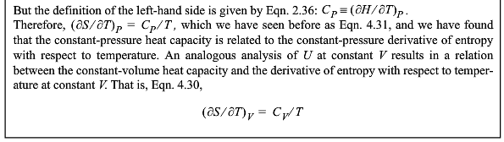

Slide 22
Example 6.3
S(T,P)
dS(T,P) = (dS/dT)_{P}dT + (dS/dP)_{T}dP
(dS/dT)_{P}=C_{p}/T
And by Maxwell
(dS/dP)_{T} = -(dV/dT)_{P} = -Vα_{P}
dS(T,P) = C_{P}dT/T - Vα_{P} dP

Slide 23
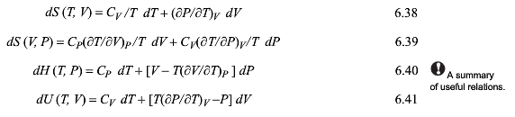

From the definitions of C_{p} and C_{v} and the chain rule changes in the state functions can be defined in terms of measurable parameters:

Slide 25

-S U V
H A
-P G T

Slide 26
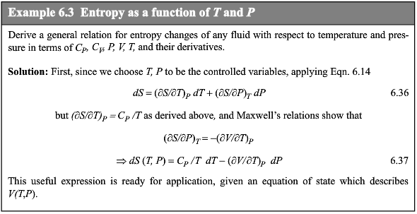

Slide 27
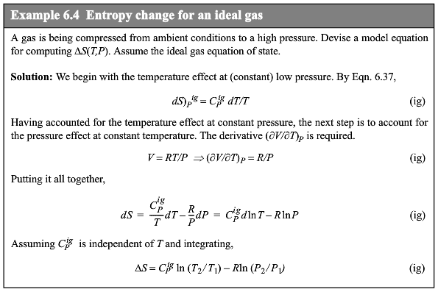

Slide 28
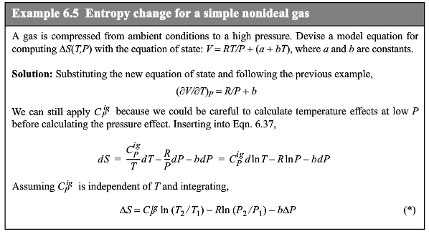

Slide 29
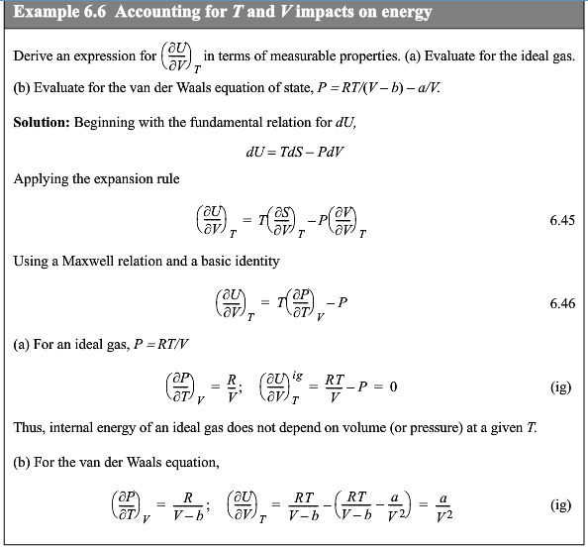

Slide 30
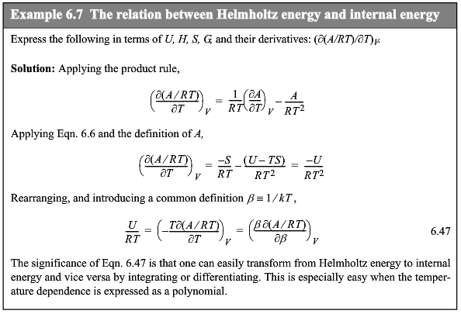

Slide 31
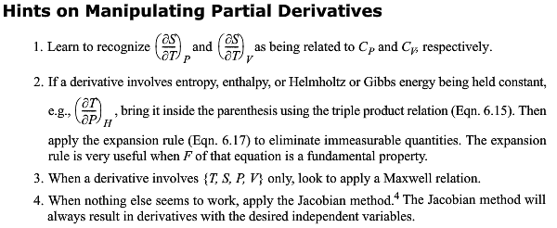

Slide 32
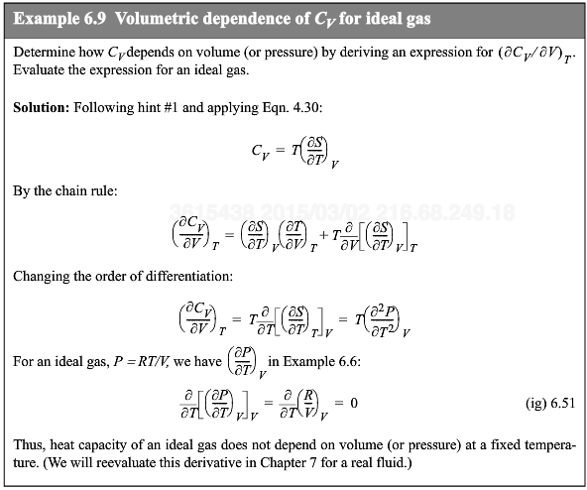

Slide 33
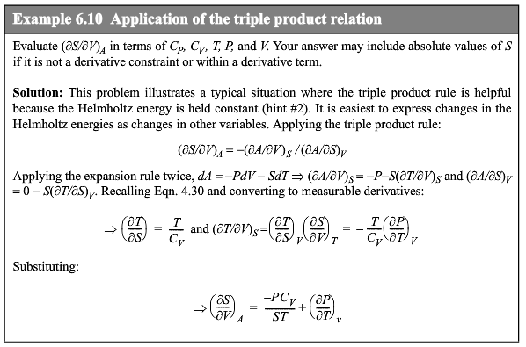

Slide 34
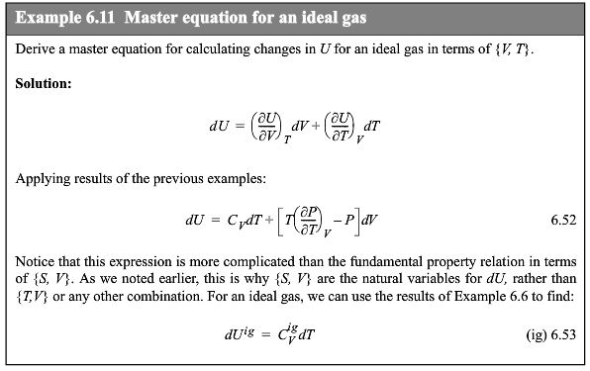

Slide 35
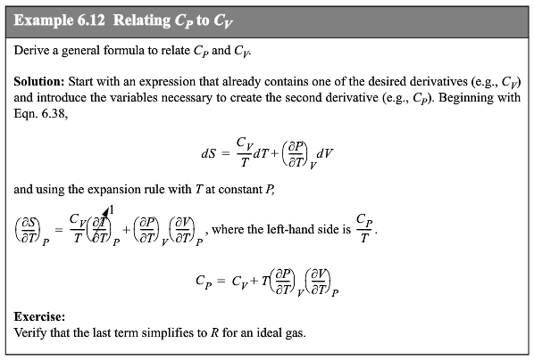

Slide 36
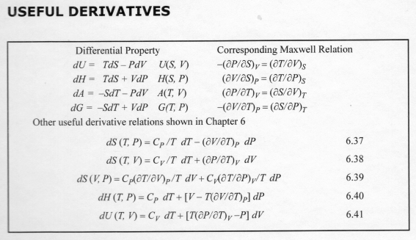
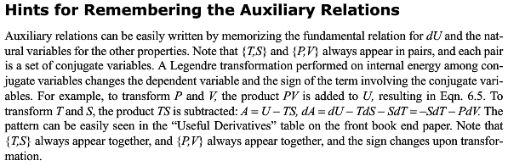

Slide 37
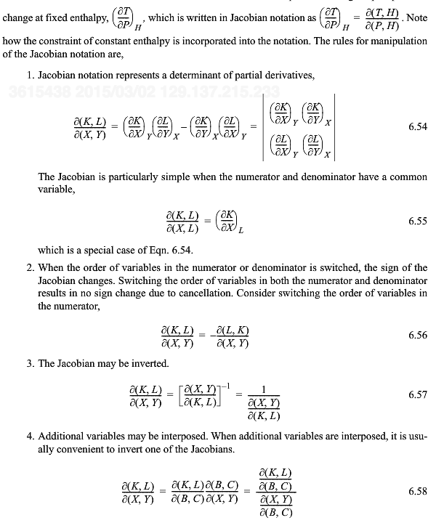

Slide 38
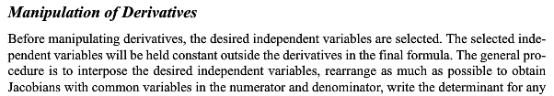
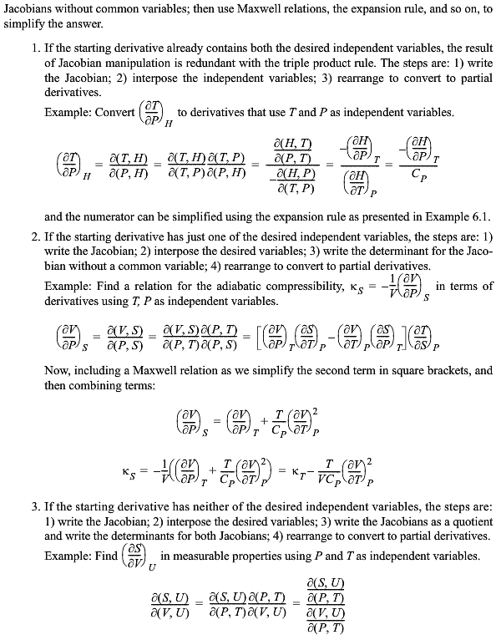

Slide 39
